Slide 1


Presented by:
PRIYA
TARUN
MAHIMA
DILEEP
JOY BENNY

Slide 2



COMPREHENSIVE
DIGITAL MARKETING
TOPIC
YESBANK

Slide 3
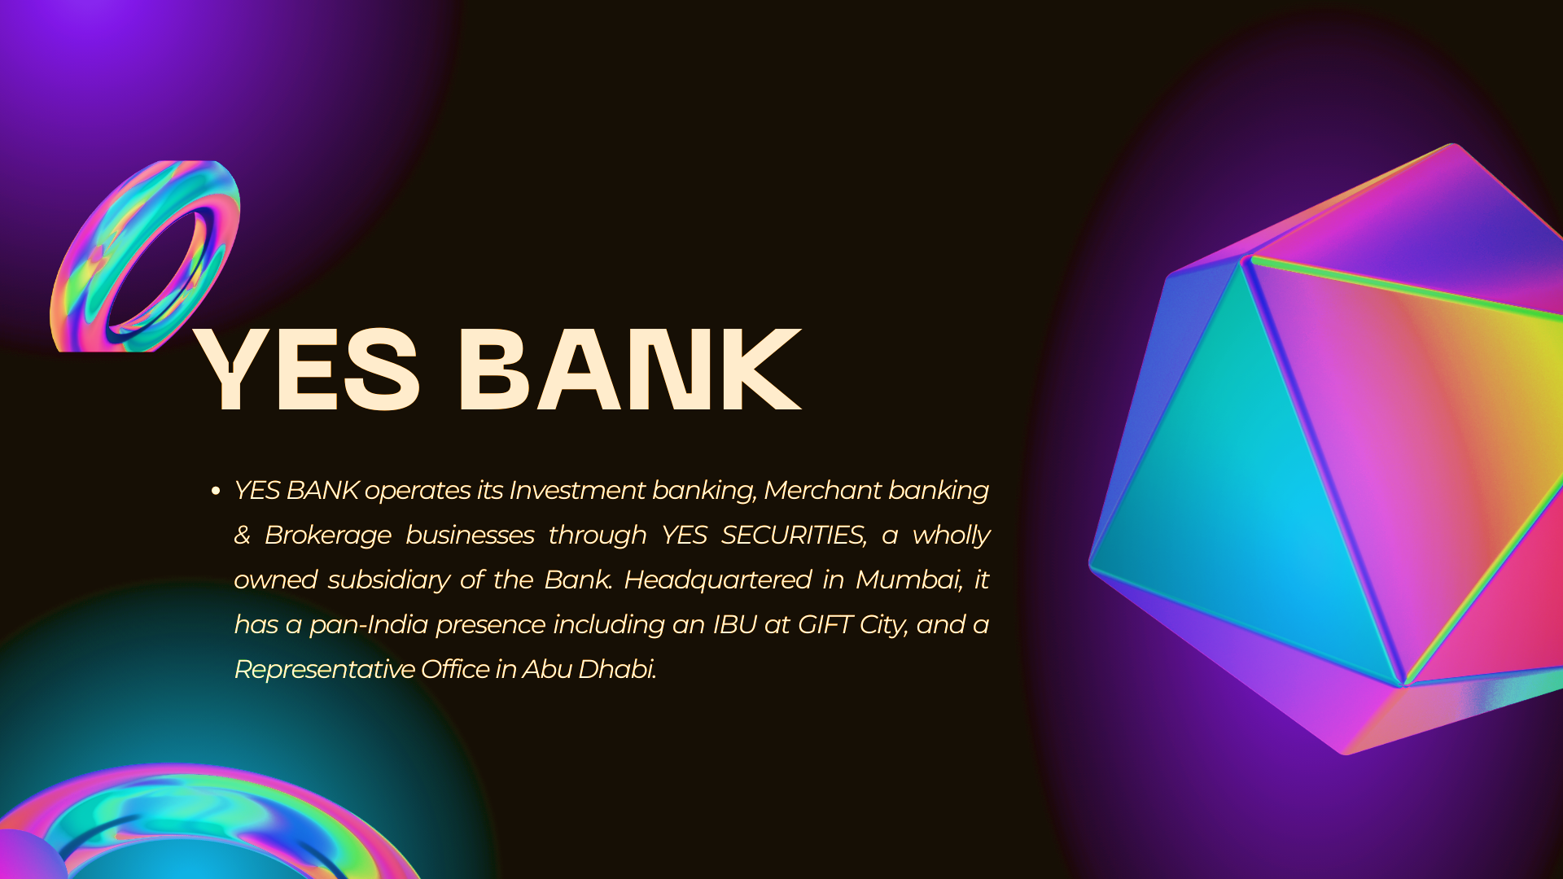

Slide 4

Part 1: Brand study, Competitor Analysis & Buyer’s/Audience’s Persona
Research Brand Identity:
Brand’s Mission:
To establish a high-quality, customer-centric, service-driven, private Indian Bank catering to the
'Future Businesses of India’.
Brand’s Values:
Yes bank tagline was 'Life Ko Bana o Rich', reflects they objective to encourage customers to spend time and make memories with their loved ones, and leave their banking needs.
Brand’s Vision:
Yes bank is committed to furthering the Government's vision of a 'less cash' economy. And to be recognized as the 'Finest Quality Large Bank of the World in India' by 2020.
Brand’s Unique Selling Propositions (USPs):
In a competitive marketplace, it is important to have a unique selling proposition to sustain oneself.
Over 800 top startups, including 55 unicorns, in India, have placed their trust with YES BANK,
the bank believes in using technology as a competitive advantage and espouses its adoption.

Slide 5

Analysis of Brand Messaging:
Marketing Strategy of Yes Bank analyses the brand with the marketing mix framework which covers the 4Ps Product, Price, Place, Promotion. Yes Bank Marketing Strategy & Mix covers its product, pricing, advertising & distribution strategies.
Now let us know about the yes bank marketing tricks.
The promotional and advertising strategy in the Yes Bank marketing strategy is as follows:
Yes bank uses various methods of promotions mostly viaTV commercials, print advertisements through major newspapers, print advertisements on its branches.
Examine the brand's tagline:
Yes Bank is all set to roll out an integrated campaign with the tagline – 'Life Ko Bana o Rich' - which represents the bank's core focus of being a complete solution provider for every financial matter.

Slide 6

Competitor Analysis:
COMPETITOR-1:
HDFC Bank - Public company founded in 1994 based in
Mumbai.
COMPETITOR-2:
RBL Bank -Public company founded in 1943 based in
Mumbai.
COMPETITOR-3:
IndusInd Bank -Acquired company founded in 1994 based in
Pune.
COMPETITOR-4:
IDFC First Bank - Public company founded in 2015 based in
Mumbai.

Slide 7

Buyer's/Audience's Persona:
Each visitor is at a different stage in the buying cycle and thinks and acts differently than the next they all have different wants or needs.
Competitive, Spontaneous, Humanistic, and Methodical are the four types of online purchasing personas
Unlike the target audience, which will merely summarize your ideal customer, the buyer persona digs deeper to uncover important information about your target customer.
This information helps you develop a deeper understanding of customers to easily meet their needs and increase customer retention
Audience profiling is a great place to start when trying to define your target personas.
By using audience segmentation tools that not only take into account specifics like age, gender and location, but lifestyles, attitudes, self-perceptions and interests, you can create detailed personas.

Slide 8

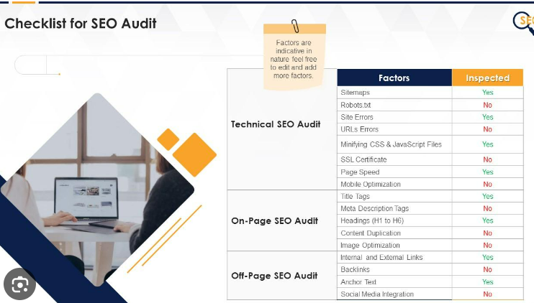
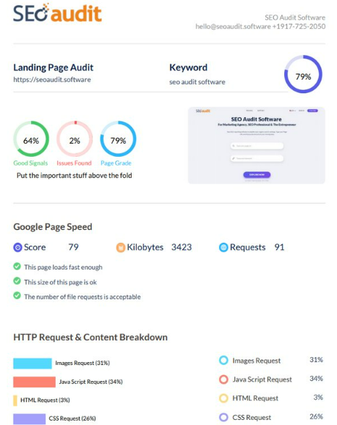
Part 2: SEO & Keyword Research
SEO Audit of yes bank website:

Slide 9

Keyword Research:
Research Objectives:
To establish a high-quality, customer-centric, service-driven, private Indian Bank catering to the 'Future Businesses of India.
Brainstorm Seed Keywords:,
Brainstorming for keywords is the process of generating seed keyword ideas. These seed keywords are what you will plug into to generate additional ideas and eventually select an single keyword to target for your niche site.

Slide 10

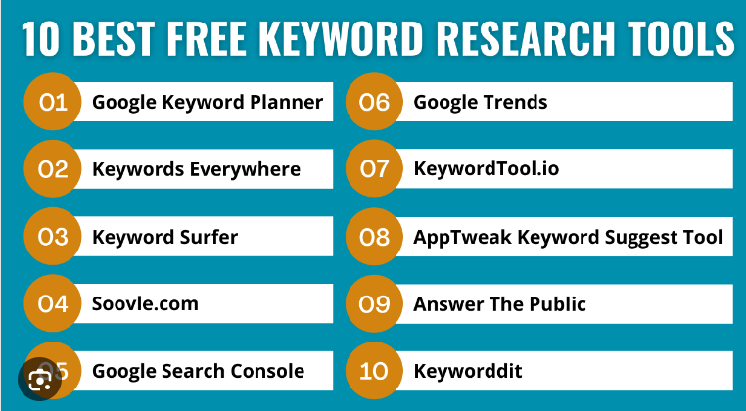
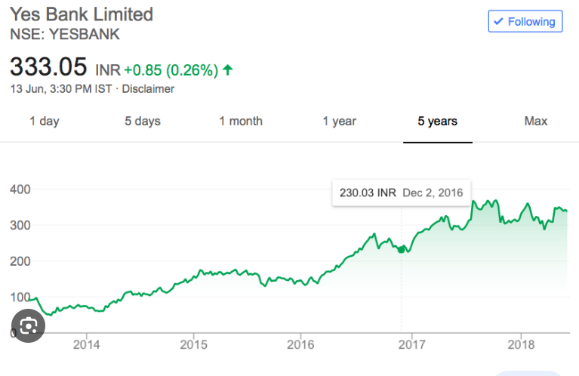
Keyword Research Tools

Slide 11

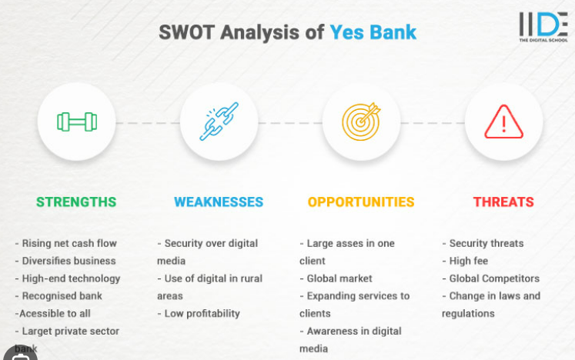
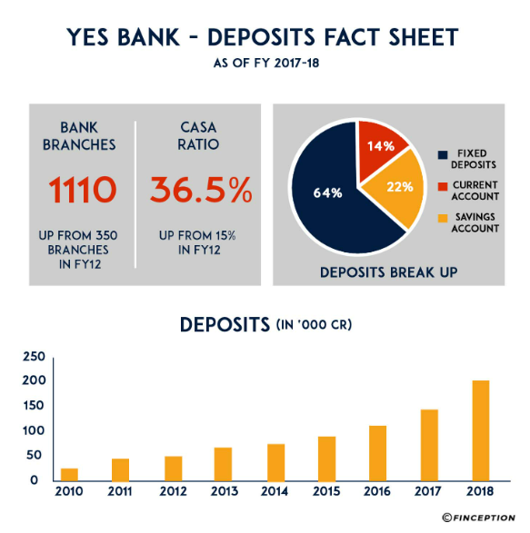
Analysis of Competitor keywords:

Slide 12

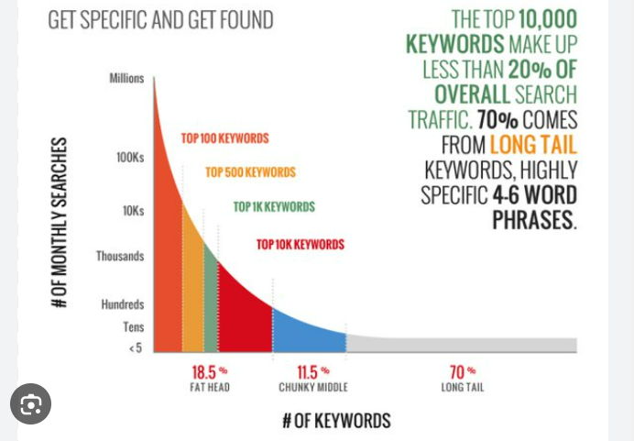
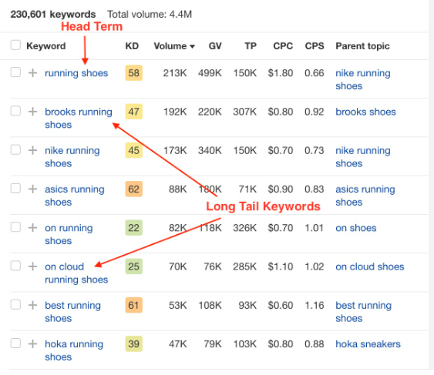
Long-tail Keyword
Long-tail keywords are longer and more specific keyword phrases that visitors are more likely to use when they’re closer to a point-of-purchase or when they’re using voice search Most long-tail keywords have lower search volume than short or “head” keywords.

Slide 13

On page Optimization: Meta Tag optimization & content optimization
YES BANK transformed its website – www.yesbank.in - by moving to SLA based, Oracle managed Oracle Content Management platform service and simplified their operational management while also achieving new age capabilities around Digital Asset Management, AI/ML and Video production. The Bank’s website now has a very low TCO with Oracle Content Management based Web Experience Delivery. The corporate website for the Bank was running on Oracle WebCenter Sites for the last few years and it was time for a version upgrade.
Meta Description for SEO:
Create unique descriptions for each page on your site.
Include relevant information about the content in the description.
Programmatically generate descriptions.
Use quality descriptions.
The meta description summarizes a page's content and presents that to users in the search results.

Slide 14

Content optimization for SEO:
Content optimization includes identifying and adding keywords, improving readability, focusing on quality, updating meta information, and linking to external and internal sources. The best way to create ranking articles is by using content optimization tools.
How to optimize content for SEO:
Make sure you're targeting a keyword with traffic potential. ...
Make sure it aligns with search intent. ...
Make sure it covers everything searchers want to know. ...
Make sure it's easy and enticing to read. ...
Make sure it has a compelling title tag and description. ...
Make sure it has enough backlinks.

Slide 15
Process of conducting keyword research and the SEO
recommendations :
Keyword research is the process of finding and analyzing search terms that people enter into search engines with the goal of using that data for a specific purpose, often for search engine optimization (SEO) or general marketing.
There are 4 stages of SEO: keyword research, readability check, linking, and marketing. While each is important on its own, you'll see the best results by ensuring the stages are supporting one another.
Listen to your customers. Hopefully, you're doing this step already!
Type their questions into a search engine.
Research the popularity and competition of keywords.
Start using keywords on your website.

Slide 16

In this guide, we’ll cover three steps of keyword research:
Listen to your customers. Hopefully, you're doing this step already! ...
Type their questions into a search engine.
Research the popularity and competition of keywords.
Start using keywords on your website.
Track your results.

Slide 17
Challenges faced during the research and analysis phase, as well as the key insights gained from the keyword research process.
What is Keyword Research?
Keyword research is the process of finding and analyzing search terms that people enter into search engines with the goal of using that data
Keyword research also involves categorizing search queries into the different stages of a user journey and different categories of search, such as transactional, navigational, and informational.
A keyword research tool helps you find topic ideas that people are searching for on search engines like Google, Bing, Amazon, etc.

Slide 18

Why is Keyword Research Important ?
Keyword research helps you to gain understanding of what your target audience are currently searching on search engines like Google or Bing.
Using keywords in digital marketing helps to optimize your content for search engines, making it easier for potential customers to find your website.
They enable readers to glean a quick impression about what they are going to read from an academic article.
A keyword is a word or phrase that signifies the meaning or main ideas of a data set. They often are used as an index to the contents of a data set.

Slide 19
Why Research and Analyze Keywords?
A financial analysis will not only help you understand your company's financial condition, helping you determine its creditworthiness, profitability and ability to generate wealth, but will also provide you with a more in-depth look at how well it operates internally.
Yes Bank's reputation for innovation and client-focused approaches attracted me to apply for this role. I have gained extensive experience in financial analysis and strategic planning, which aligns with the job

Slide 20
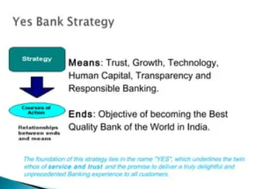
How to do Keyword Research as Part of Your SEO Strategy?
• Now that I've outlined the need-to-know concepts above, we can dive into the details of how to actually conduct
your research.
• The processes I've outlined below are ones I use personally and recommend to our clients. It will help you identify
head terms to target, long-tail keywords to drive targeted traffic and create the content that will help you achieve
your goals.
Our process includes five, easy-to-follow steps:
1.Identify the most relevant topics.
2.Match topics with seed keywords (or head terms).
3.Research more deeply in line with your core topics.
4.Refine those keywords to identify the biggest opportunities.
5.Prioritize keywords to focus on first.

Slide 21
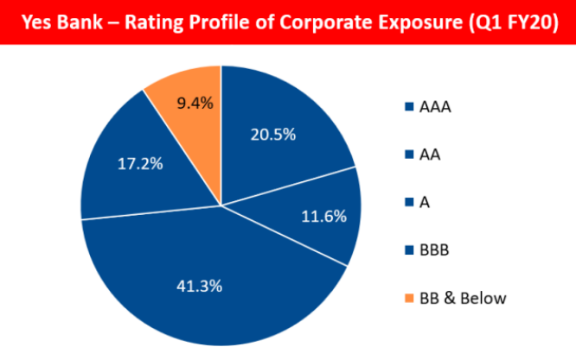

Slide 22

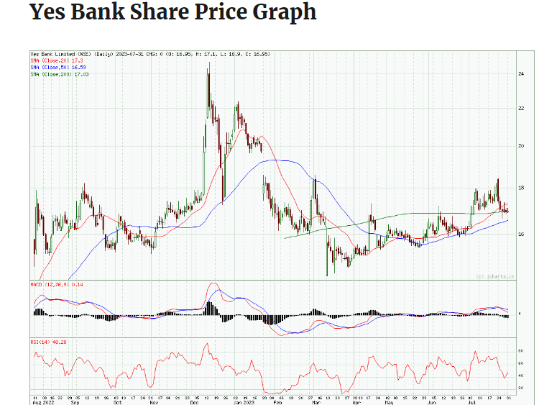

Slide 23
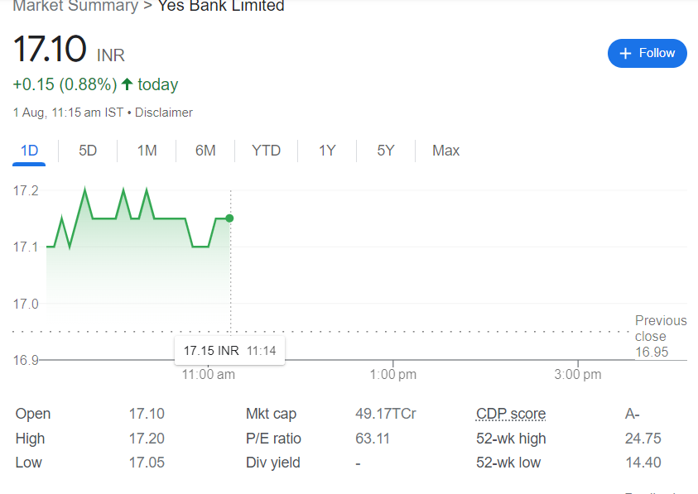

Slide 24
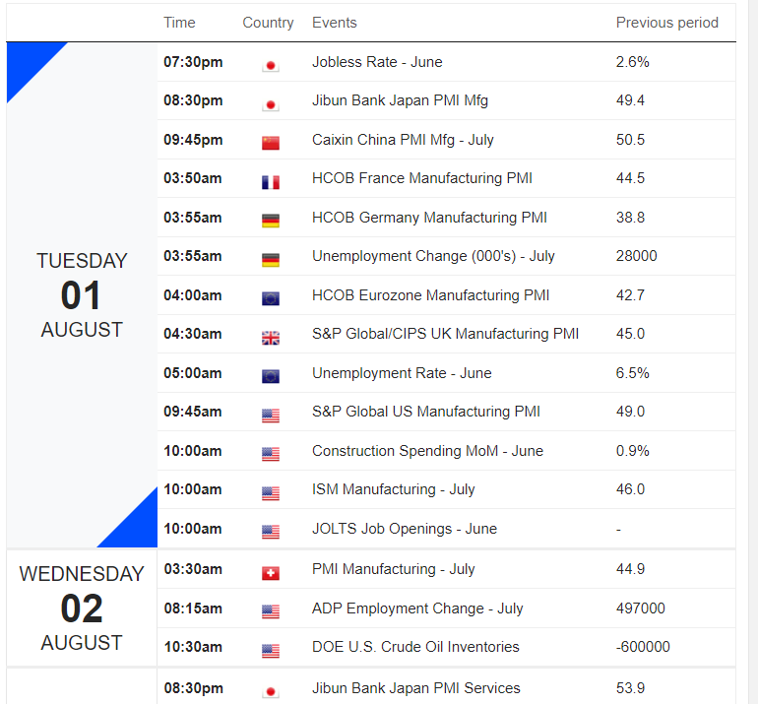
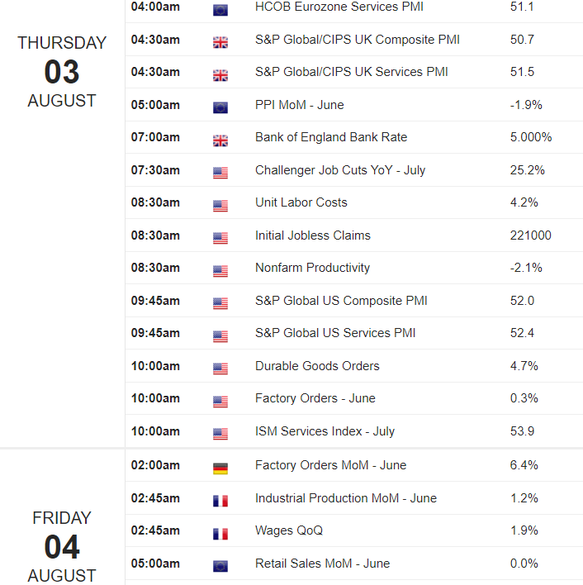
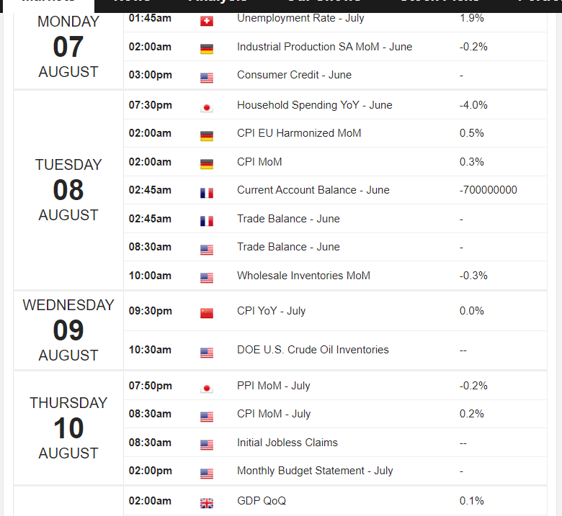
Part 3: Content Ideas and Marketing Strategies
CONTENT CALENDAR

Slide 25
Strategy, Aim and the Idea behind these posts and stories:
YES BANK, in line with its corporate social responsibility policy, has worked conscientiously to align its core business more closely with global sustainability frameworks, chiefly the United Nations’ Sustainable Development Goals, the Paris Agreement on Climate Change and the Principles for Responsible Banking. Guided by its CSR and ESG policies, the Bank works to deliver positive socio-environmental impact within these frameworks.
The Bank has developed and implemented CSR programs to create and enhance shared value through unique, scalable and sustainable models. With a focus on 3Es – Employability, Entrepreneurship and Environment Sustainability - the Bank has committed to catalyze employment and entrepreneurship opportunities for 100,000 youth by 2026. Additionally, a target of planting 1 million trees over next five years has been taken as we understand that protecting the environment has a direct bearing on sustainability.

Slide 26

CONTENT IDEAS AND MARKETING STRATEGIES PROCESS:
1. Reflect on the content ideas:
YES BANK believes in a knowledge driven approach to banking and has deployed a strategic four-pronged, approach to its sustainable financing work. The following attributes of the bank’s financing mechanism make it a winning strategy.
2.Marketing Strategies Process
The bank believes chat to achieve any strategic out come , short, medium and long term goals are important. Aligned to this thought, YES BANK has announced many targeted commitments towards sustainability and climate action
3.DISCUSSING THE CHALLENGES ENCOUNTERED:
The bank in a structured way puts in a place relevant policies and process that help achieve the aforementioned targets. YES BANK accordingly has in a place a detailed set of internal guidelines for its green bond principle complaints The bank also instituted an environment &social policy to guide its lending decisions , while its resource management in upheld by Environmental Management Policy.
4.LESSONS LEARNED:
To further bolster its approach to sustainable finance , the bank has become a active member of highly credible coalitions .YES BANK ,as the first Indian signatory to the UNEP FI , a global partnership between UNEP and financial sector , continues to play a leadership role at the platform .

Slide 27
How to Create a Content Strategy Framework:
Define your goal.
Conduct persona research.
Run a content audit.
Choose a content management system.
Determine which type of content you want to create.
Brainstorm content ideas.
Publish and manage your content.

Slide 28

Testimonials and reviews.
Repurpose content.
Update old content.
Encourage user-generated content.
Guest blogging.
Create videos on social media.
Host a podcast.
Offer lead magnets in exchange for email

Slide 29
Challenges encountered and lessons learned in marketing strategies:
Supervision needs to be strict. RBI gave a huge rope to Yes Bank management.
Bank chief executive officers should not be allowed long tenures as seen in t he case of several CEO’s who have faced issues with the central bank.
There must be a clear separation of ownership and control of a bank
All the stake holders, including bank boards auditors and the regulator have to maintain constant vigil, given the high stake s for safety and stability

Slide 30
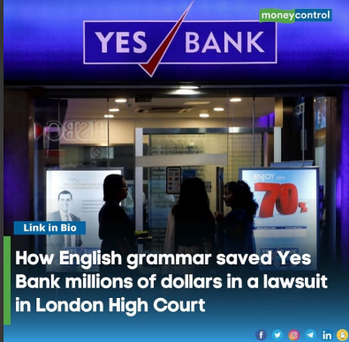
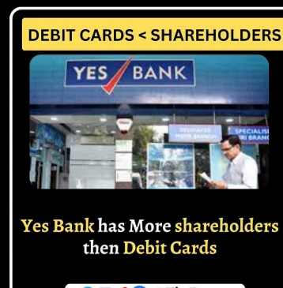
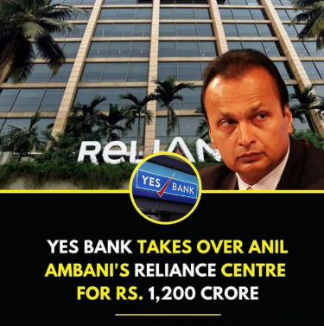
Part 4: Content Creation and Curation
Post Creation

Slide 31
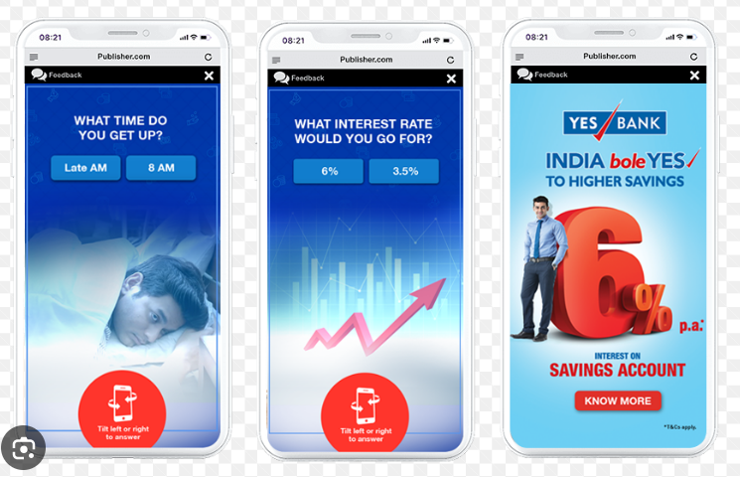

Slide 32

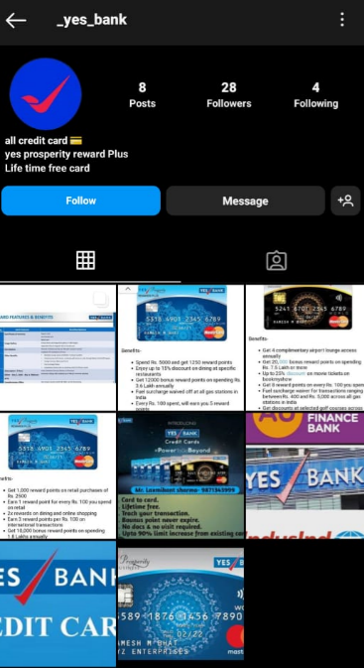
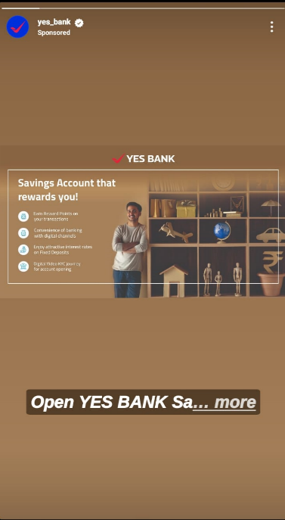
Instagram Story

Slide 33
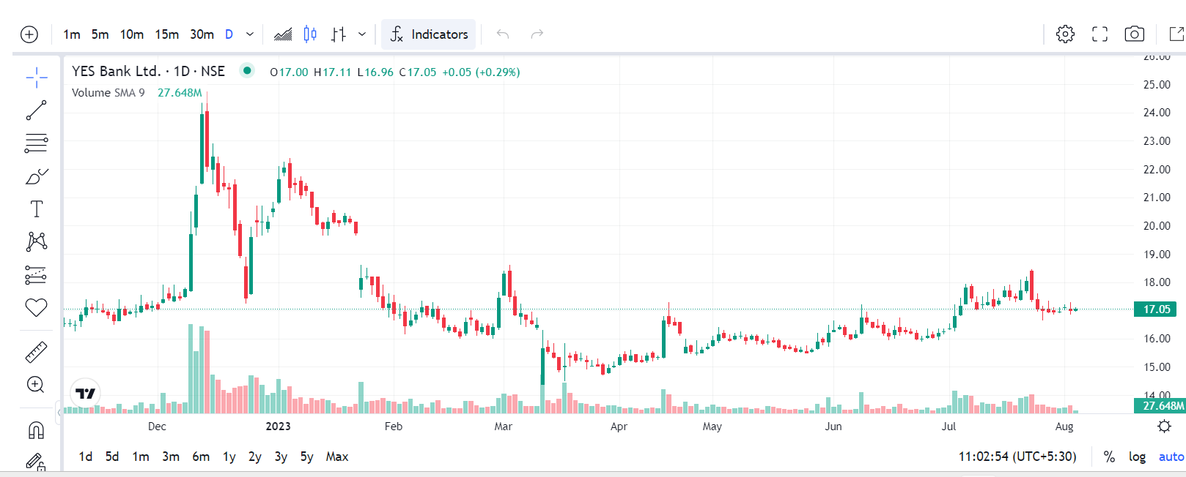
INSIGHT TOOL ANALYSE:

Slide 34
Strategies and Areas for Improvement:
9 Ways to Improve the Customer Experience in Banking
Make it easier for new customers to open an account. ...
Get conversational. ...
Embrace open banking. ...
Make your mobile app more intuitive. ...
Deflect from IVR to digital channels. ...
Provide customers with self-service opportunities. ...
Tie products to life events at the right time.

Slide 35



Designs/Video Editing
Tools Familiarization

Slide 36
✓Advertising Goals.
Brand Awareness:
The tick has been transformed into a soaring bird, which represents the Bank's current position of 'soaring'. Moreover, the smoothened out corners and fluid shapes have replaced the angular edges of the older identity, along with a more emphatic typography
.Driving website traffic:
YES BANK also focuses on internal capacity building in the environmental sustainability domain by creating a learning environment for its employees.
Generating leads:
CARE upgraded the rating of Yes Bank to A- from BBB+ earlier with a positive outlook stating that the bank has turned stable

Slide 37
Audience Targeting:
Our target audience is the Indians of today who have a positive mindset and are willing to work towards realizing their dreams and aspirations. They are optimistic people who believe that tomorrow would be better than today and are willing to invest in building that better tomorrow.

Slide 38

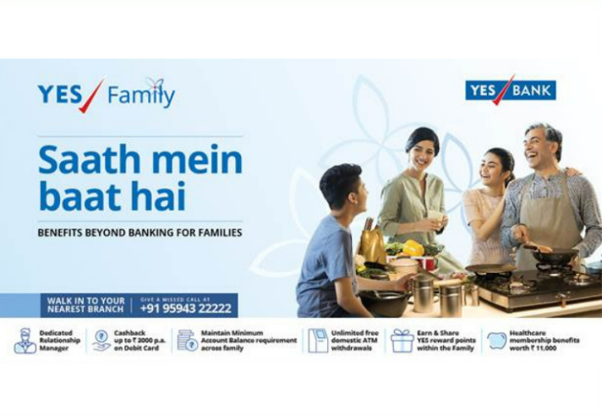
Visually appealing ad creatives, compelling ad copy and relevant call-to-action:

Slide 39
Email Ad Campaigns:
1. Brand Awareness:
The promotional and advertising strategy in the Yes Bank marketing strategy is as follows: Yes bank uses various methods of promotions mostly via TV commercials, print advertisements through major newspapers, print advertisements on its branches.
2. Generation lead:
A: Lead generation, or lead gen, is the process of identifying and nurturing potential customers for your business. It involves acquiring the name and contact information of someone who is interested in your product or service and preparing them to talk to a salesperson.

Slide 40
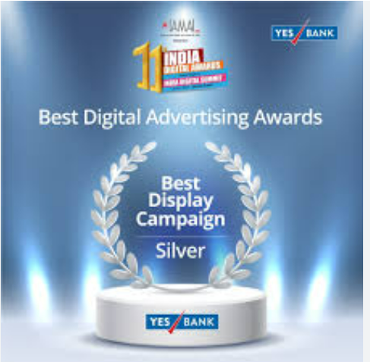
Email Ad Campaign 1
Brand Awareness

Slide 41
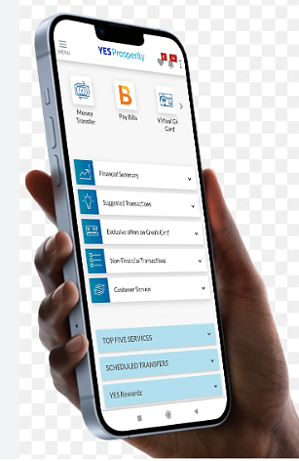
Email Ad Campaign 2 Generation lead

Slide 42
Content Creation and Curation Process
Essentially, content curation relates to finding, filtering, and sharing relevant content
created by others with your audience. On the other hand, content creation is what it
sounds like – creating new content for your audience.
Challenges faced and lessons learned:
✓Producing high-quality content.
✓Generating content consistently.
✓Prioritising content expertise.
✓Understanding different buyer personas.
✓Producing content in suitable formats.
✓Measuring content ROI.
✓Creating buy-in among stakeholders.

Slide 43
THE END

